Slide 1
Query Processing

Slide 2
architecture
query
user
Query matching
hits
Learning component
feedback
(documents and their descriptions)
Notes:
This is a rather general diagram that illustrates an IR system at work. It illustrates a number of things:
1) The object base (I tried to use a neutral term - objects could be database records, reports, multi-media objects), usually contains a description of the objects as well as the objects themselves. This is not like a schema in a database, but rather it is some sort of summary that tries to capture the meaning or informational content of the object to be retrieved. Indeed, bibliographic IR systems often have the description and not the objects (ie documents) themselves.
2) All IR systems have some sort of matching component that compares a user’s request with the object descriptions and returns those items that match.
3) What sort of language is used to describe the objects and to formulate the queries and what sort of matching is done to match an object with a user query varies from one IR system to another and gives the system its characteristics.
4) Some IR systems have a sort of learning component that, based on feedback from the user adjusts either the object descriptions, or the users query or the method of matching to provide a better response. I believe use of feedback is an important aspect of IR systems; experiments have shown how it can help to improve effectiveness
5) the figure also shows that the objects or items returned to the user are called ‘hits’ or sometimes ‘postings.

Slide 3
basic notation
Given a list of m documents, D, and a list of n index terms, T, we define w_{i,j}  0 to be a weight associated with the i^{th} keyword and the j^{th} document.
For the j^{th} document, we define an index term vector, d_{j} :
d_{j} = (w_{1,j} , w_{2,j} , …., w_{n,j} )
Recipe for jam pudding
For example: D = { d1, d2, d3},
T = {pudding, jam, traffic, lane, treacle}
d₁ = (1, 1, 0, 0, 0),
d₂ = (0, 0, 1, 1, 0),
d₃ = (1, 1, 1, 1, 0)
DoT report on traffic lanes
Radio item on traffic jam in Pudding Lane
Notes:
The idea of identifying a document and an index term according to its position in a list may seem a bit odd at first, but whether this is actually how it is done in the computer is not really important. The maths representation gives us a convenient way of describing what we want to do. So, for example, in general the index term vectors will be thousands of elements long and have only a few bits set to 1. We wouldn’t store them like that, but that doesn’t matter, we can still represent then that way in the models.

Slide 4
Statistical vector model
weights, 1  w_{i,j}  0, no longer binary-valued
query also represented by a vector
q = (w_{1q}, w_{2q}, …, w_{nq})
eg q = (1.0, 0.6, 0.0, 0.0, 0.8)
T = {pudding, jam, traffic, lane, treacle}
to match j^{th} document with a query:
sim(d_{j}, q) = d_{j}  q /( | d_{j} | ×| q | )
=
_{i=1}
n
(w_{ij} × w_{iq})
_{i=1}
_{i=1}
n
n
w_{ij} ² ×
w_{iq} ²
Notes:
Now we come to the next classical model. The person most closely associated with the vector model is Gerard Salton. The textbook on your book list by Salton and McGill is well worth reading if you can find a copy - it is almost certainly out of print, buit there are copies in the library. Salton’s work is well-represented in other texts, for example that by Baeza-Yates and Ribeiro-Neto.
The first change we see is that index-term vectors associated with documents take elements that are no longer constrained to 0 or 1. This means we can use weights to say how important a keyword is to a document. The Jam pudding recipe might be represented by:
(0.8, 0.8, 0.0, 0.0, 0.2)
This tells us that ‘pudding’ and ‘jam’ are important keywords for this recipe, but perhaps the recipe has a footnote that says (‘For a variation on this recipe you can use treacle instead of jam’), so treacle gets a 0.2 weight.
The second change is that, instead of Boolean queries, we now represent a query also as a term vector of weights. The query shown might reflect an interest in puddings (for sure), treacle pudding preferably, but jam pudding is a good second best. Note that because there is no Boolean logic there is no way of expressing the fact that treacle is an alternative to jam.
The matching (similarity) coefficient is the so-called ‘Cosine’ coefficient. It is not the only possible matching coefficient, but (as we shall see) has the useful properties that:
a) 0 <= sim(a, b) <= 1 for all a and b
b) sim(a, b) = 1 if and only if a = b where  is a constant)
c) sim(a, b) = 0 if a and b are orthogonal (ai = 0 whenever bi > 0 and vice versa)
Other matching coefficients have been proposed, normally they have these properties and it turns out that choice of matching coefficient is not too critical for the performance of the system.

Slide 5
Cosine coefficient
_{i=1}
n
(w_{ij} × w_{iq})
T1
= cos()
_{i=1}
_{i=1}
n
n
D1
w_{ij} ² ×
w_{iq} ²
w₁₁
w_{1q}
Q

w₂₁
w_{2q}
T2
Notes:
This slide illustrates the meaning of the similarity coefficient. We work in a 2-D space (just two index terms) and show the vector for one document (D1) and a query (Q). The similarity coefficient is actually the cosine of the angle between the two vectors.
This means that it is only the relative weights of the query (or document) that matter. If I double all the weights in my query I will double the length of the query vector, but the angle stays the same and the sim(d, q) stays the same.

Slide 6
Cosine coefficient
_{i=1}
n
(w_{ij} × w_{iq})
T1
= cos(0)
= 1
_{i=1}
_{i=1}
n
n
D1
w_{ij} ² ×
w_{iq} ²
w₁₁
w_{1q}
Q
=0
w₂₁
w_{2q}
T2
Notes:
This slide says, if the query vector and the document vector are perfectly aligned, then the cosine is 1 (max). This will happen if the doc and query have exactly the same keywords as one another, and the relative weights between the keywords is also the same for each vector.

Slide 7
Cosine coefficient
_{i=1}
n
(w_{ij} × w_{iq})
T1
= cos(90º)
= 0
_{i=1}
_{i=1}
n
n
w_{ij} ² ×
w_{iq} ²
D1
w₁₁
= 90º
w_{1q= 0}
Q
w₂₁₌ ₀
w_{2q}
T2
Notes:
This slide says, if the query vector and the document vector are orthogonal (90 degrees), then the cosine is 0 (min). This will happen if the doc and query have no keywords in common.

Slide 8
q = (1.0, 0.6, 0.0, 0.0, 0.8)
d₁ = (0.8, 0.8, 0.0, 0.0, 0.02) Jam pud recipe
_{i=1}
n
(w_{ij} × w_{iq})
= 0.8×1.0 + 0.8×0.6 + 0.0×0.0 + 0.0×0.0 + 0.2×0.8
= 1.44
_{i=1}
n
w_{ij} ²
= 0.8² + 0.8² + 0.0² + 0.0² + 0.2² = 1.32
_{i=1}
n
w_{iq} ²
= 1.0² + 0.6² + 0.0² + 0.0² + 0.8² = 2.0
_{i=1}
n
(w_{ij} × w_{iq})
= 1.44 = 0.89
1.32 × 2.0
_{i=1}
_{i=1}
n
n
w_{ij} ² ×
w_{iq} ²
Notes:
This and the next two slides just do the calculations

Slide 9
q = (1.0, 0.6, 0.0, 0.0, 0.8)
d₂ = (0.0, 0.0, 0.9, 0.8, 0), DoT Report
_{i=1}
n
(w_{ij} × w_{iq})
= 0.0×1.0 + 0.0×0.6 + 0.9×0.0 + 0.8×0.0 + 0.0×0.8
= 0.0
_{i=1}
n
w_{ij} ²
= 0.0² + 0.0² + 0.9² + 0.8² + 0.0² = 1.45
_{i=1}
n
w_{iq} ²
= 1.0² + 0.6² + 0.0² + 0.0² + 0.8² = 2.0
_{i=1}
n
(w_{ij} × w_{iq})
= 0.0 = 0.0
1.45 × 2.0
_{i=1}
_{i=1}
n
n
w_{ij} ² ×
w_{iq} ²

Slide 10
q = (1.0, 0.6, 0.0, 0.0, 0.8)
d₃ = (0.6, 0.9, 1.0, 0.6, 0.0) Radio Traffic Report
_{i=1}
n
(w_{ij} × w_{iq})
= 0.6×1.0 + 0.9×0.6 + 1.0×0.0 + 0.6×0.0 + 0.0×0.8
= 1.14
_{i=1}
n
w_{ij} ²
= 0.6² + 0.9² + 1.0² + 0.6² + 0.0² = 2.53
_{i=1}
n
w_{iq} ²
= 1.0² + 0.6² + 0.0² + 0.0² + 0.8² = 2.0
_{i=1}
n
(w_{ij} × w_{iq})
= 1.14 = 0.51
2.53 × 2.0
_{i=1}
_{i=1}
n
n
w_{ij} ² ×
w_{iq} ²

Slide 11
collecting results
T = {pudding, jam, traffic, lane, treacle}
q = (1.0, 0.6, 0.0, 0.0, 0.8)
Rank document vector document (sim)
1. d₁ = (0.8, 0.8, 0.0, 0.0, 0.2) Jam pud recipe (0.89)
2. d₃ = (0.6, 0.9, 1.0, 0.6, 0.0) Radio Traffic (0.51) Report
Notes:
The vector model allows documents to be ranked according to the value of the similarity coefficient. This value is not necessarily returned to the user of course.

Slide 12
Query Expansion

Slide 13
Why Query Expansion
Queries formed by Search engine users are generally short and vague.
Studies have shown that the average query length is only around 2-3 words.
It is very difficult to estimate the exact needs of the user.
For example the query “apple price in market” , It is not clear from the word apple for fruit or Computer.

Slide 14
Why query expansion?
Sometimes, the queries are well formed and clear, but the document does not contain the information in same form as in query.
To give suggestions to the user.
Synonymous and related terms are presented in the collection.
Query expansion adds terms to the original query which provides more information to the user needs.

Slide 15
Approaches for query Expansion
Query expansion methods are broadly classified as-
Local methods use documents that are retrieved by original query.
Relevance Feedback
Pseudo Relevance Feedback
Global methods are independent of the query and results returned from it.
Thesaurus or WordNet
Concept Clouds.

Slide 16
The idea of relevance feedback(RF) is to involve the user in the retrieval process so as to improve the final result set. In particular, the user gives feedback on the relevance of documents in an initial set of results. The basic procedure is:
• The user issues a (short, simple) query.
• The system returns an initial set of retrieval results.
• The user marks some returned documents as relevant or non-relevant.
• The system computes a better representation of the information need based on the user feedback.
• The system displays a revised set of retrieval results

Slide 17
Relevance Feedback
After initial retrieval results are presented, allow the user to provide feedback on the relevance of one or more of the retrieved documents.
Use this feedback information to reformulate the query.
Produce new results based on reformulated query.
Allows more interactive, multi-pass process.

Slide 18
Relevance Feedback Architecture
Document
corpus
Query String
Revised
Query
IR
System
Rankings
ReRanked
Documents
1. Doc2
2. Doc4
3. Doc5
.
.
Query
Reformulation
Ranked
Documents
1. Doc1
2. Doc2
3. Doc3
.
.
1. Doc1 ⇓
2. Doc2 ⇑
3. Doc3 ⇓
.
.
Feedback

Slide 19
Relevance feedback with user relevance information
Two basic techniques
Query expansion
Add new terms from relevant documents
Term reweighting
Modify term weights based on user relevance judgements Increase weight of terms in relevant documents and decrease weight of terms in irrelevant documents i.e.
Emphasise some terms (relevant ones)
De-emphasise other terms (non-relevant ones)
Advantages
Shield users from details of query reformulation process
Search broken down in sequence of small steps

Slide 20
Query expansion and term reweighting in the vector space model
For a query q
Dr: set of relevant documents among retrieved documents
Dn: set of non-relevant documents among retrieved documents
Cr: set of relevant documents among all documents in collection

Slide 21
Standard Rochio Method
Since all relevant documents unknown, just use the known relevant (D_{r}) and irrelevant (D_{n}) sets of documents and include the initial query q.
α: Tunable weight for initial query.
β: Tunable weight for relevant documents.
γ: Tunable weight for irrelevant documents.

Slide 22
Rochio formula
Initial formulation α=1
Usually information in relevant documents more important than in non-relevant documents (γ<<β)
Positive relevance feedback (γ=0)

Slide 23
Ide “Dec Hi” Method
Bias towards rejecting just the highest ranked of the irrelevant documents:
α: Tunable weight for initial query.
β: Tunable weight for relevant documents.
γ: Tunable weight for irrelevant document.

Slide 24
Comparison of Methods
Overall, experimental results indicate no clear preference for any one of the specific methods.
All methods generally improve retrieval performance (recall & precision) with feedback.
Generally just let tunable constants equal 1.

Slide 25
Fair Evaluation of Relevance Feedback
Remove from the corpus any documents for which feedback was provided.
Measure recall/precision performance on the remaining residual collection.
Compared to complete corpus, specific recall/precision numbers may decrease since relevant documents were removed.
However, relative performance on the residual collection provides fair data on the effectiveness of relevance feedback.

Slide 26
Why is Feedback Not Widely Used
Users sometimes reluctant to provide explicit feedback.
Results in long queries that require more computation to retrieve, and search engines process lots of queries and allow little time for each one.
Makes it harder to understand why a particular document was retrieved.

Slide 27
Pseudo Feedback
Use relevance feedback methods without explicit user input.
Just assume the top m retrieved documents are relevant, and use them to reformulate the query.
Allows for query expansion that includes terms that are correlated with the query terms.
Found to improve performance on TREC competition ad-hoc retrieval task.

Slide 28
Global Methods
Global methods are independent of the query and results returned from it.
Thesaurus or WordNet
Concept Clouds.

Slide 29
Thesaurus
A thesaurus provides information on synonyms and semantically related words and phrases.
Example:
physician
syn: ||croaker, doc, doctor, MD, medical, mediciner, medico
rel: medic, general practitioner, surgeon,

Slide 30
Thesaurus-based Query Expansion
For each term, t, in a query, expand the query with synonyms and related words of t from the thesaurus.
May weight added terms less than original query terms.
Generally increases recall.
May significantly decrease precision, particularly with ambiguous terms.
“interest rate” → “interest rate fascinate evaluate”

Slide 31
WordNet
A more detailed database of semantic relationships between English words.
Developed by famous cognitive psychologist George Miller and a team at Princeton University.
About 144,000 English words.
Nouns, adjectives, verbs, and adverbs grouped into about 109,000 synonym sets called synsets.

Slide 32
WordNet Synset Relationships
Antonym: front → back
Similar: unquestioning → absolute
Cause: kill → die
Entailment: breathe → inhale
Holonym: chapter → text (part to whole)
Meronym: computer → cpu (whole to part)
Hyponym: plant → tree (specialization)
Hypernym: apple → fruit (generalization)

Slide 33
Automatic Thesaurus/Concept clouds
Existing human-developed thesauri are not easily available in all languages.
Human thesuari are limited in the type and range of synonymy and semantic relations they represent.
Semantically related terms can be discovered from statistical analysis of corpora.

Slide 34
Problems with Global Analysis
Term ambiguity may introduce irrelevant statistically correlated terms.
“Apple computer” → “Apple red fruit computer”
Since terms are highly correlated anyway, expansion may not retrieve many additional documents.

Slide 35
Query Expansion Conclusions
Expansion of queries with related terms can improve performance, particularly recall.
However, must select similar terms very carefully to avoid problems, such as loss of precision.

Slide 36
Google’s Query Expansion
Word stemming
The term searched is reduced to a root or ‘stem’- words of the same stem can be ranked for the search containing only one of them.
Example:
Translator search matches “translator“, “translation“

Slide 37
Google’s Query Expansion…
Acronyms:
An abbreviation / acronym / initialism searched is automatically resolved to the full version.
If there are several possible variants of one and the same acronym, Google will do its best to mention all variations on the first page in the following order:
(1) most popular and hence most probable one
(2) all the rest.

Slide 38
Google’s Query Expansion…
Example:
nato will be resolved as:
(1) “North Atlantic Treaty Organization” and (2) “North American Telemark Organization” (3)“NORTHERN ARTS TACTICAL OFFENSIVE“

Slide 39
Google’s Query Expansion…
Misspellings:
Google will suggest the correct variant as well as list sites that use that correct variant.
Google uses some (unclear) algorithm for typos:
Example:
City wigets will both suggest searching for correct variant -’city widgets‘- and list sites for ‘city widgets‘ search

Slide 40
Google’s Query Expansion…
Synonyms:
Sometimes Google includes related words in the search results.
Example:
Internet connexion search will pull ‘Internet connection‘ in most cases.

Slide 41
Google’s Query Expansion…
Translations:
In some instances, Google seems to translate search keywords into other languages and return results from that language.
Example:
Internet verbindung search will pull “Internet Connection”

Slide 42
Google’s Query Expansion…
Ignored words:
Occasionally some (“insignificant“) words appear to have been dropped completely from the query.
Example:
Slow cable internet problem search will in a few cases drop the word “problem“

Slide 43
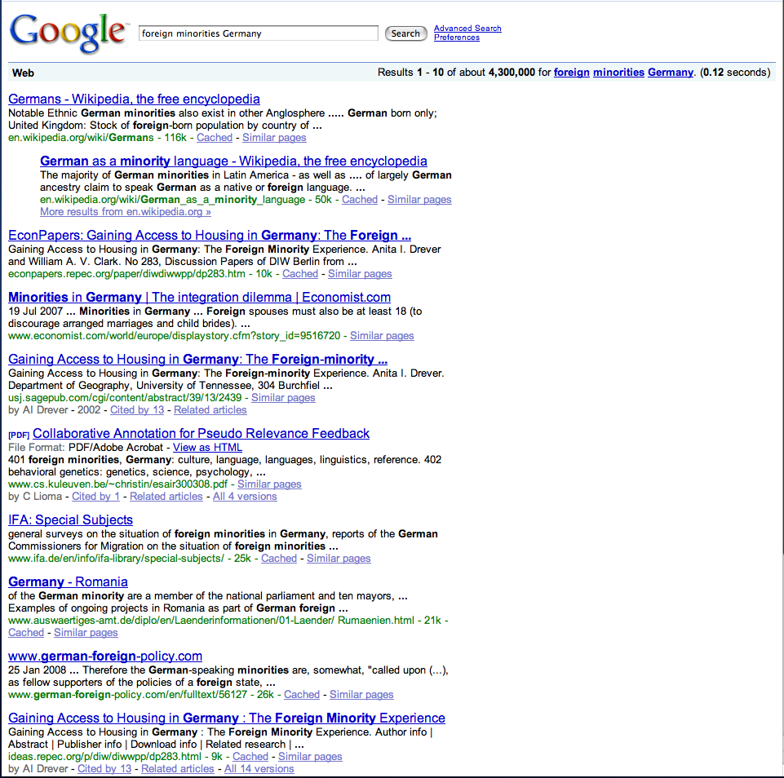
Google’s Query Expansion…
Query Logs:
The expansion term are identified at least in part on the new terms and probabilistic correlations from information in a query log. The query log information includes one or more query terms and a corresponding set of document identifiers (IDs).

